Slide 1



DATA MOGULS
TEAM MEMBERS:
GREGORY WOOLERY, SAMUEL MATHESON
REANNA JOHNSON, MURPHY FACEY

Slide 2

PROBLEM
The service being provided by the innovation of data moguls is one that seeks to solve the problem of a lack of affordable and readily available assistance to the visually impaired. There is a gap in this industry as much progress has not been made to ease the burdens of the visually impaired.

Slide 3
SOLUTION TO THE PROBLEM
Our App seeks to solve this problem by providing a user friendly interface for the visually impaired.
This app will guide our target market through their lives with the much needed assistance as well allowing them to maintain a high level of privacy.

Slide 4
BUSINESS MODEL CANVAS SEGMENTS:

Slide 5

CUSTOMER SEGMENT
visually impaired individuals
Visually impaired individuals including, but not limited to people who are completely blind or otherwise have limited vision
Family/Guardians of visually impaired individuals
Blind people often need assistance from family in some capacity

Slide 6
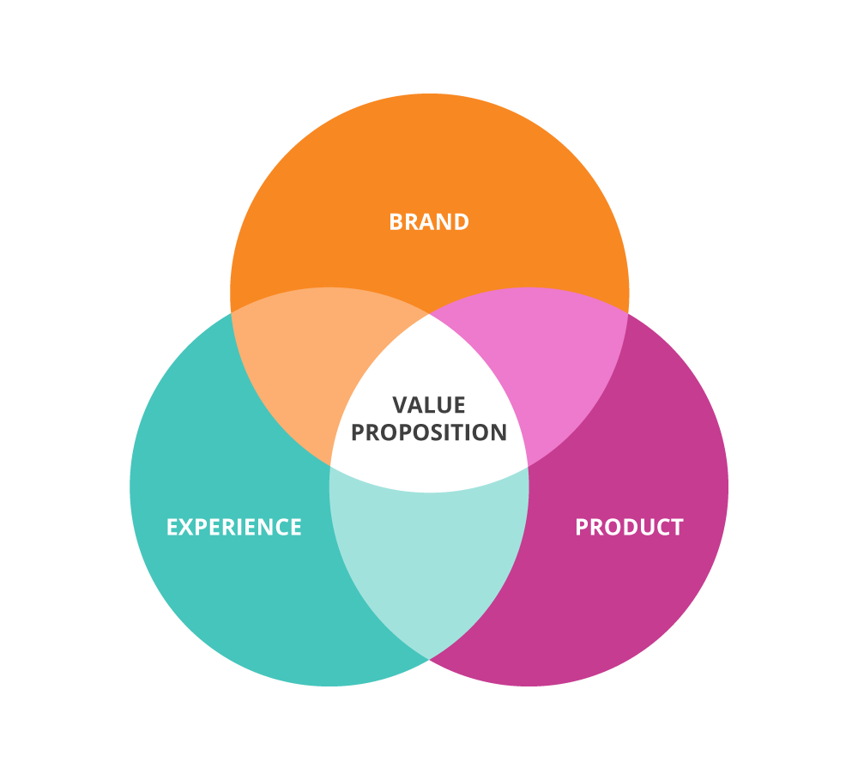

Slide 7
VALUE PROPOSITION
Affordable prices
Offer subscription discounts
Convenience, speed of service
Visual Aid with privacy
Provide remote visual assistance to customers

Slide 8
CHANNELS
Mobile App
Mobile application used to process input from the environment and manage subscriptions and payments may also be used to communicate with users
Social Media (Instagram, facebook, twitter)
Social media interactions are a useful tool for dispersing information, communicating with customers
Word of Mouth
Word of mouth, while being unpredictable word of mouth is the most effective way to disperse knowledge about a product or service

Slide 9
CUSTOMER RELATIONSHIP
Build customer focused relationships
Good relations with customers will lead to more positive interactions and more repeat customers
Building rapport with customers
It is important your customers trust you
Attending to enquiries within 24 hours
Rapid Feedback for customer enquiries are important, as in this case it could potentially be a safety concern
Support customer needs
The needs of customers are important, not fulfilling them is the best way to sink a companies prospects

Slide 10
REVENUE STREAMS
Subscriptions for the app-
-Standard
-Gold $2,500/month
-Premium $4,000/month
Added fees for extra assistance- $500/hour

Slide 11

KEY RESOURCES
Start-up Capital
Network Infrastructure
Programmers
Developers
Staff

Slide 12
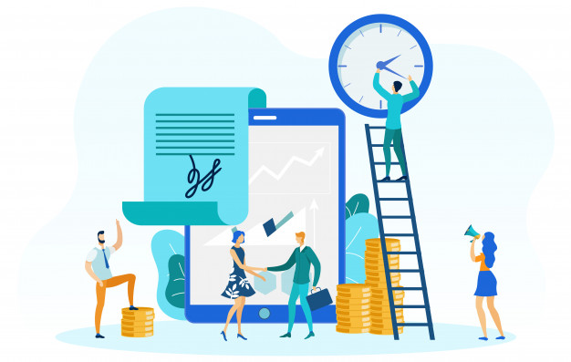
KEY ACTIVITIES
Regular App updates
Granting Subscription requests
Monitoring staff, staff requests and staff schedules

Slide 13
KEY PARTNERS
Jamaica Society for Blind People
Insurance Companies

Slide 14

COST STRUCTURE
Copyright app name : $3,500
Employees’ salaries :
Employees would be paid based on the amount of hours spent providing assistance to customers. Assistants will be paid $370/hour per client
Fee for uploading app: 25 USD $3,663 JMD.

Slide 15
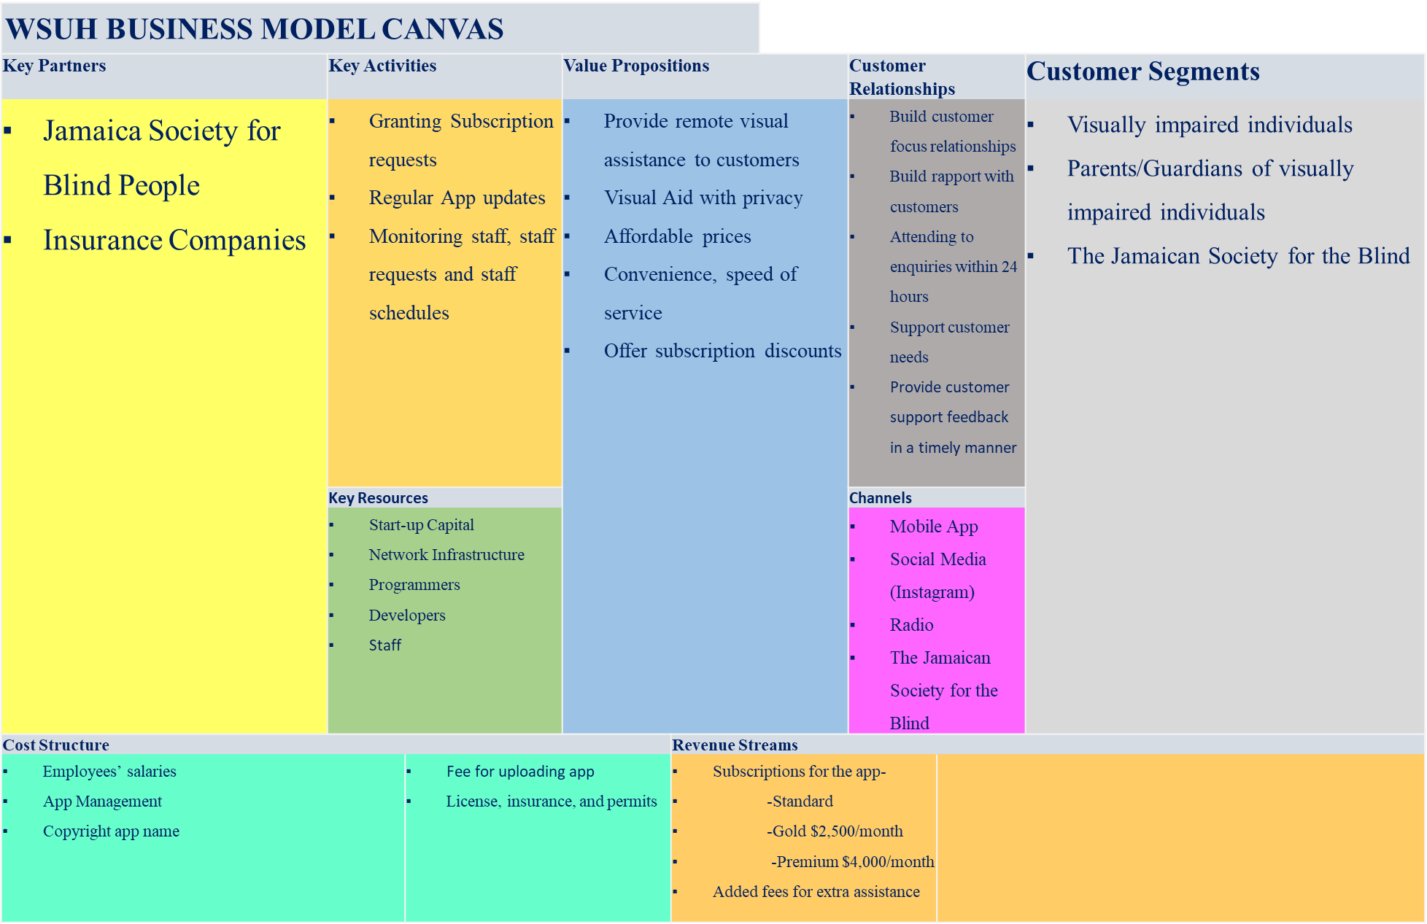

Slide 16
DATA MOGULS BMC – YOUTUBE LINK
https://youtu.be/-YeAoZAHyrs

